Slide 1
Monitoring system

Slide 2
Team members
Khaled Tamer ElNaggar : 211001835 Abdallah emam : 211001541
Abdelaziz amr : 211001650
Youssef ahmed ibrahem : 211002055
Ahmad elsayed :211001765
Omar Alshafaey: 19100227

Slide 3

Project goal
Design and develop a system monitoring tool capable of monitoring various system parameters such as CPU usage, memory usage and process information.

Slide 4
Our functions

Slide 5
Function 1 : get_cpu_usage()
Purpose: Calculate the CPU usage of the system.
Explanation:
Open File Opens `/proc/stat` to read CPU statistics.
Read Values: Reads CPU time spent in user, nice, system, and idle modes.
Calculate Usage: Computes total and busy CPU time.
Return CPU Usage: Returns the ratio of busy time to total time as a percentage.
Key Points:
Error Handling: Prints an error and returns -1.0 if the file cannot be opened.
Metrics: Uses `/proc/stat` to get precise CPU times.

Slide 6
Function 2 : get_memory_usage()
Purpose: Calculate the memory usage of the system.
Get System Info: Uses `sysinfo` to retrieve system information.
Calculate Usage: Computes the ratio of used memory to total memory.
Key Points:
Error Handling: Prints an error and returns -1.0 if `sysinfo` fails.
Metrics: Utilizes `sysinfo` structure to get memory stats.

Slide 7
Function 3 : get_disk_usage()
Purpose: Calculate the disk usage of the root filesystem.
Explanation:
Get Filesystem Stats: Uses `statvfs` to get filesystem statistics for the root directory.
Calculate Usage: Computes the ratio of used space to total space.
Key Points:
Error Handling: Prints an error and returns -1.0 if `statvfs` fails.
Metrics: Relies on `statvfs` structure to get disk space details

Slide 8
Function 4 : get_running_processes()
Purpose: Get the number of currently running processes.
Explanation:
Open File: Opens `/proc/loadavg` to read load average and process stats.
Extract Value: Parses the number of running processes from the file content.
Key Points:
Error Handling: Returns -1 if the file cannot be opened or read.
Metrics: Uses the fifth field in `/proc/loadavg`.

Slide 9
Function 5 : get_network_usage()
Purpose: Calculate the network usage in MB.
Explanation:
Open File: Opens `/proc/net/dev` to read network interface statistics.
Read Values: Sums up received (RX) and transmitted (TX) bytes for all interfaces.
Convert to MB: Converts byte values to megabytes.
Key Points:
Error Handling: Sets RX and TX to 0 if the file cannot be opened.
Metrics: Reads byte counts from network interfaces.

Slide 10
Function 6 : get_uptime()
Purpose: Calculate the system uptime in minutes.
Explanation:
Get System Info: Uses `sysinfo` to retrieve system information.
Convert to Minutes: Converts uptime from seconds to minutes.
Key Points:
Error Handling: Prints an error and returns -1.0 if `sysinfo` fails.
Metrics: Uses the `uptime` field from the `sysinfo` structure.

Slide 11
Function 7 : get_battery_status()
Purpose: Retrieve the battery status and capacity.
Explanation:
Read Capacity: Reads battery capacity from `/sys/class/power_supply/BAT0/capacity`.
Read Status: Reads battery status from `/sys/class/power_supply/BAT0/status`.
Key Points:
Error Handling: Prints an error and sets defaults if files cannot be opened.
Metrics: Reads capacity percentage and status string.

Slide 12
Function 8 : check_for_alerts()
Purpose: Check for and print alerts based on system usage thresholds.
Explanation:
CPU Alert: Checks if CPU usage exceeds the threshold.
Memory Alert: Checks if available memory is below the threshold.
Disk Alert: Checks if available disk space is below the threshold.
Key Points:
- Thresholds: Uses predefined thresholds to trigger alerts.
- Alerts: Prints alert messages for high usage conditions.

Slide 13
Function 9 : generate_report
Purpose: Generate a report on system health and status.
Explanation:
Open File: Opens `system_report.txt` in append mode.
Write Report: Writes the current system metrics to the file with a timestamp.
Key Points:
Error Handling: Prints an error if the file cannot be opened.
Metrics: Includes CPU, memory, disk, processes, network, uptime, and battery stats.

Slide 14
Function 10 : main()
Purpose: Continuously monitor and report system health.
Explanation:
Initialize: Set up the initial report time.
Monitor Loop: Continuously gather and print system metrics.
Check Alerts: Trigger alerts for abnormal system behavior.
Generate Reports: Periodically generate detailed system health reports.
Sleep: Wait for a short period before the next iteration.
Key Points:
Loop: Runs an infinite loop to monitor the system.
Report Interval: Generates reports every 60 seconds intervals.
Sleep: Sleeps for 5 seconds between checks to reduce system load.

Slide 15
Our results

Slide 16
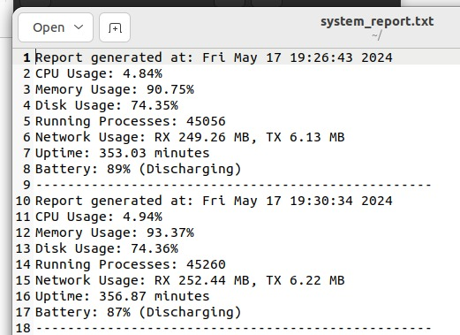
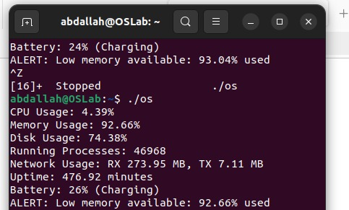

Slide 17
THANK YOU

